Slide 1
Cornerstone City Church Peninsula Plus Community Hoo Are Ya
9th November 2025

Slide 2


Slide 3
I reach Up High
CCLI Song # 1075387
Judy Bailey
© 1993 Song Solutions Daybreak (Admin. by Song Solutions www.songsolutions.org)
For use solely with the SongSelect® Terms of Use. All rights reserved. www.ccli.com
CCLI Licence No. 33265

Slide 4
1/3
I reach up high I touch the ground
I stomp my feet and turn around
I've got to (woo woo) Praise the Lord
I jump and dance with all my might
I might look funny but that's alright
I've got to (woo woo)
Praise my Lord

Slide 5
2/3
I'll do anything just for my God
'Cause He's done ev'rything for me
It doesn't matter who is looking on
Jesus is the person that I want to please

Slide 6
3/3
May my whole life be a song of praise
To worship God in ev'ry way
In this song the actions praise His name
I want my actions ev'ry day to do the same

Slide 7
Great Big God
CCLI Song # 3373437
Jo Hemming | Nigel Hemming
© 2001 Vineyard Songs (UK/Eire) (Admin. by Integrity Music Ltd)
For use solely with the SongSelect® Terms of Use. All rights reserved. www.ccli.com
CCLI Licence No. 33265

Slide 8
1/2
Our God is a great big God
Our God is a great big God
Our God is a great big God
And He holds us in His hands

Slide 9
2/2
He's higher than a skyscraper
And He's deeper than a submarine
He's wider than the universe
And beyond my wildest dreams
And He's known me and He's loved me
Since before the world began
How wonderful to be a part of
God's amazing plan

Slide 11
Your Name
CCLI Song # 4611679
Glenn Packiam | Paul Baloche
© 2006 Integrity Worship Music (Admin. by Integrity Music Ltd)
Integrity's Hosanna! Music (Admin. by Integrity Music Ltd)
For use solely with the SongSelect® Terms of Use. All rights reserved. www.ccli.com
CCLI Licence No. 33265

Slide 12
1/4
As morning dawns and evening fades
You inspire songs of praise
That rise from earth to touch Your heart
And glorify Your Name

Slide 13
2/4
Your Name is a strong and mighty tower
Your Name is a shelter like no other
Your Name let the nations sing it louder
'Cause nothing has the power to save
But Your Name

Slide 14
3/4
Jesus in Your Name we pray
Come and fill our hearts today
Lord give us strength to live for You
And glorify Your Name

Slide 15
4/4
Your Name is a strong and mighty tower
Your Name is a shelter like no other
Your Name let the nations sing it louder
'Cause nothing has the power to save
But Your Name

Slide 16
Wide as the Sky
CCLI Song # 7000697
Jonas Myrin | Kristian Stanfill | Matt Redman
© 2013 Said And Done Music (Admin. by Integrity Music Ltd)
sixsteps Music (Admin. by Integrity Music Ltd)
Thankyou Music (Admin. by Integrity Music Ltd)
worshiptogether.com songs (Admin. by Integrity Music Ltd)
Atlas Mountain Songs (Admin. by SHOUT! Music Publishing UK)
For use solely with the SongSelect® Terms of Use. All rights reserved. www.ccli.com
CCLI Licence No. 33265

Slide 17
1/3
Hands up hearts open wide as the sky
We lift You high we lift You high
Hands up hearts open wide as we cry
God, we lift Your name high
(REPEAT)

Slide 18
2/3
Let all the other names fade away
Let all the other names fade away
Until there's only You
Let all the other names fade away
Jesus take Your place
Jesus take Your place
(REPEAT)

Slide 19
3/3
Our God, we lift You high We lift You high
Hands up God we lift Your name high
Our God, we lift You high
We lift You high
Hands up God we lift Your name high
(REPEAT)

Slide 21
Yes And Amen
CCLI Song # 7048885
Chris McClarney | Nate Moore | Tony Brown
© 2016 Thankyou Music Ltd; Bethel Worship Publishing; Mouth Of The River Music; Songs Of Simply Hymns Music; Tony Brown Music Designee
For use solely with the SongSelect® Terms of Use. All rights reserved. www.ccli.com

Slide 22
1/8
Father of kindness You have poured out grace
You brought me out of darkness
You have filled me with peace
Giver of mercy You're my help in time of need
Lord I can't help but sing

Slide 23
2/8
Faithful You are
Faithful forever You will be
Faithful You are
All Your promises are Yes and Amen
All Your promises are Yes and Amen

Slide 24
3/8
Beautiful Saviour, You have brought me near
You pulled me from the ashes
You have broken ev'ry curse
Blessed Redeemer You have set this captive free
Lord I can't help but sing

Slide 25
4/8
Faithful You are
Faithful forever You will be
Faithful You are
All Your promises are Yes and Amen
All Your promises are Yes and Amen

Slide 26
5/8
I will rest in Your promises
My confidence is Your faithfulness
(REPEAT)

Slide 27
6/8
Faithful You are
Faithful forever You will be
Faithful You are
All Your promises are Yes and Amen
All Your promises are Yes and Amen

Slide 28
7/8
O Holy Spirit You have changed my life
You comfort and direct me
You have filled me with love
Teacher and defender, you're my guide in time of need
Lord I can't help but sing

Slide 29
8/8
Faithful You are
Faithful forever You will be
Faithful You are
All Your promises are Yes and Amen
All Your promises are Yes and Amen

Slide 30


Slide 31
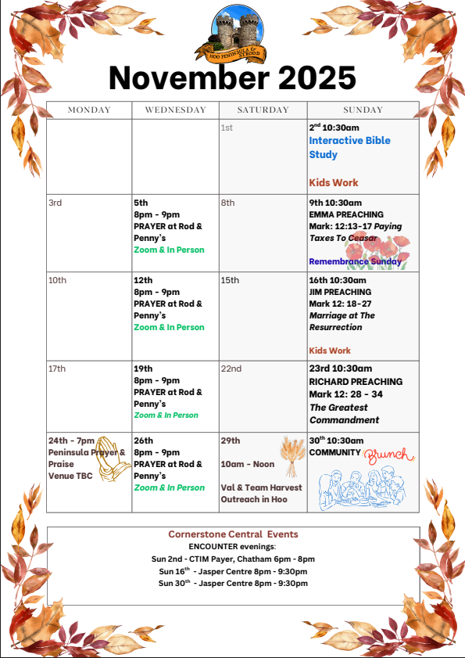

Slide 32
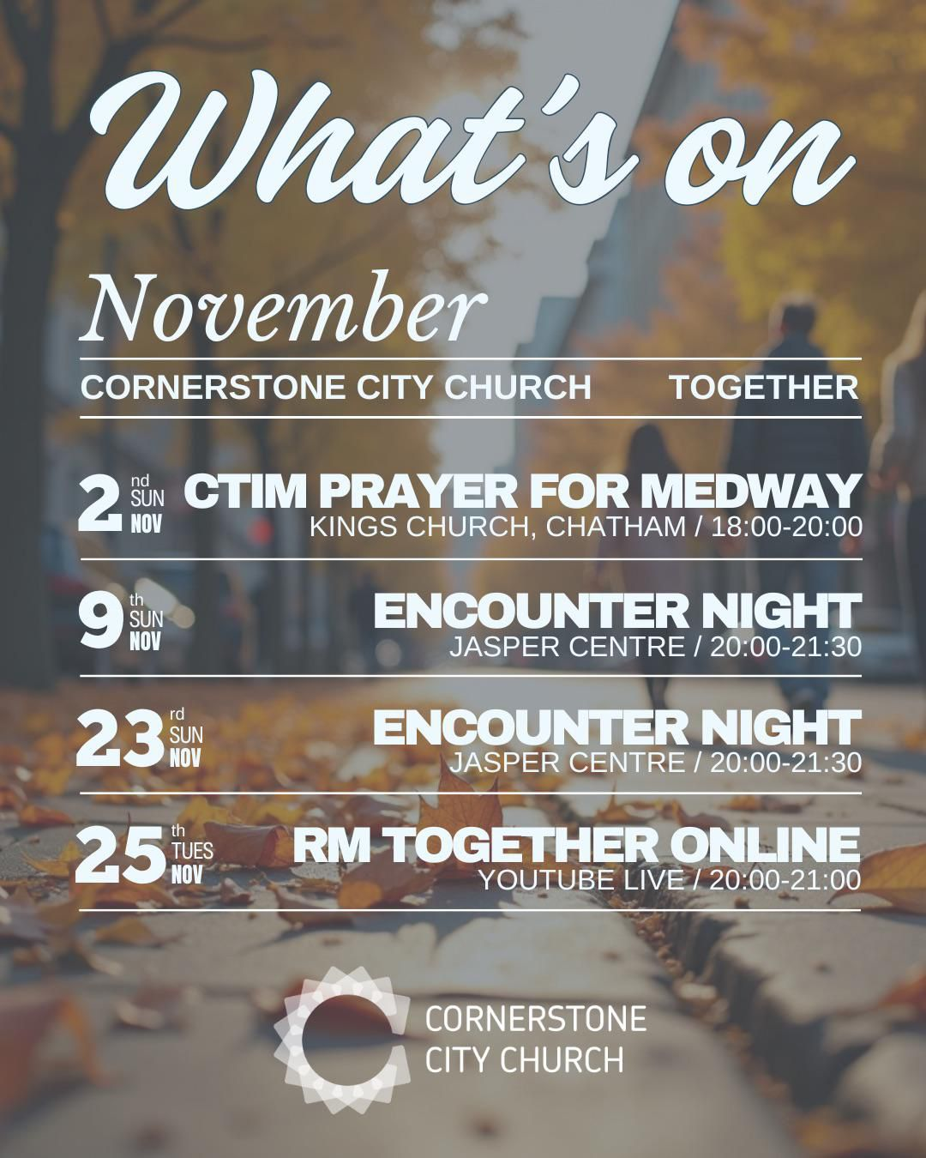

Slide 33
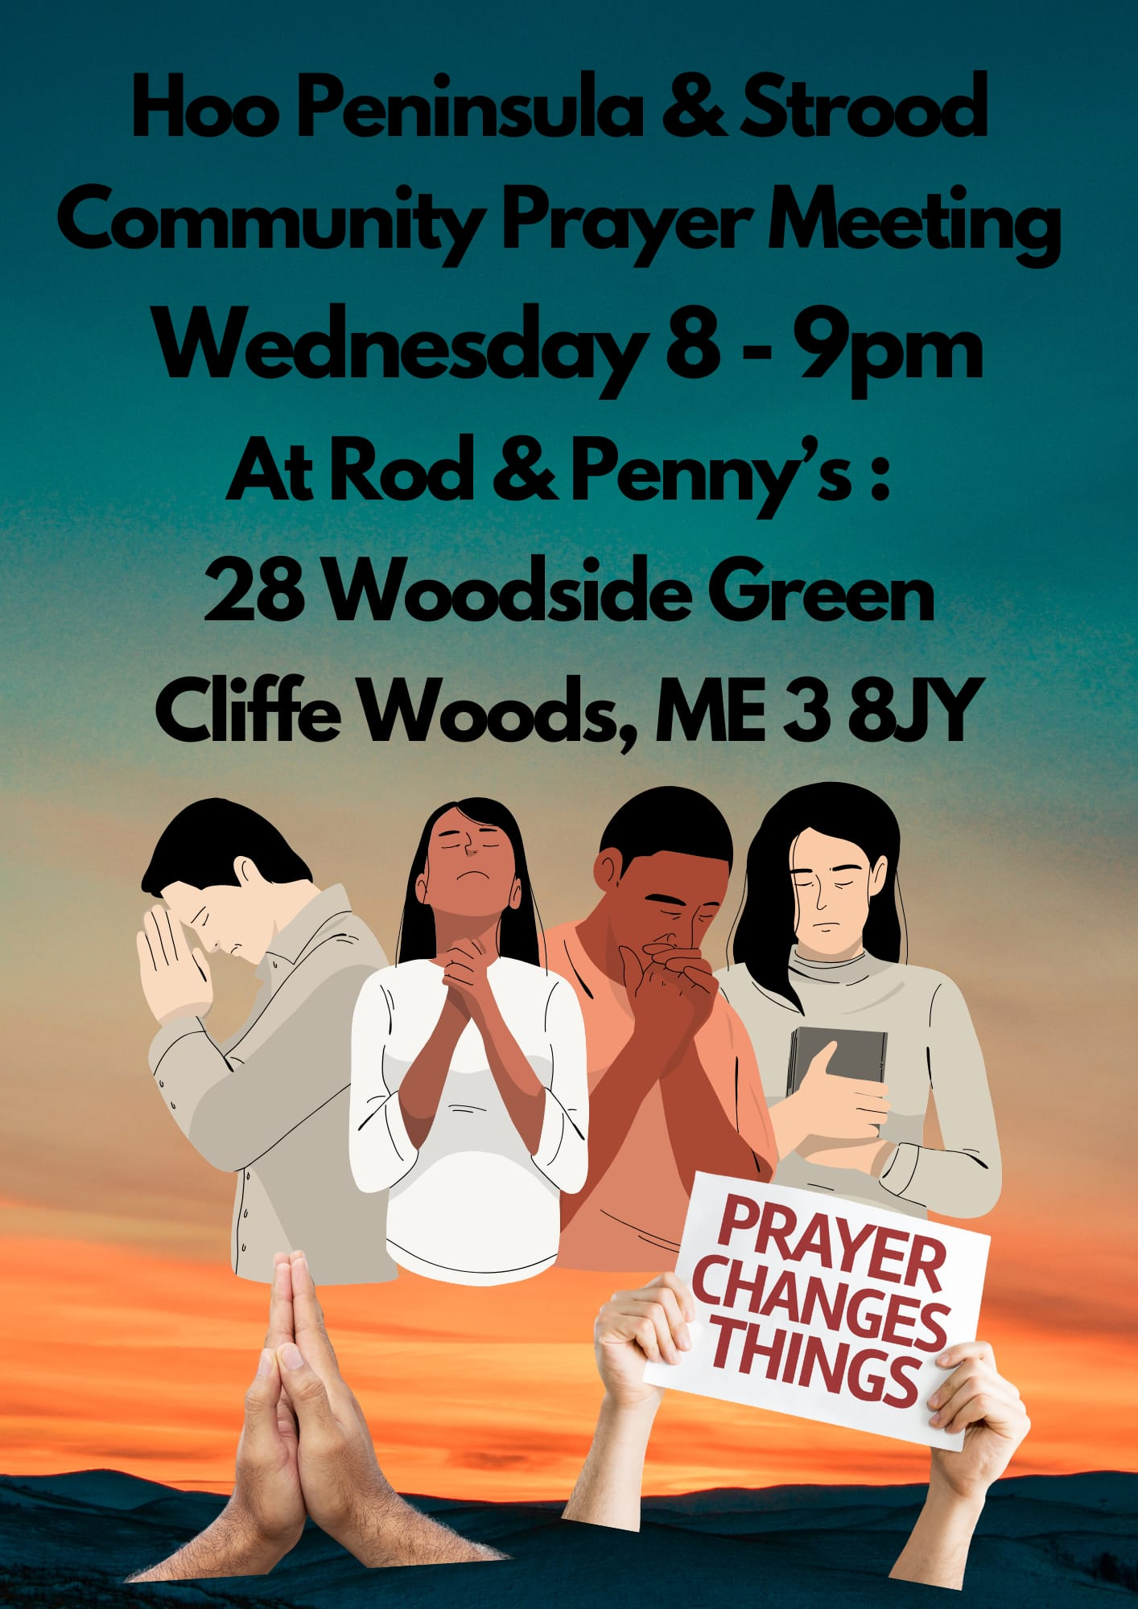

Slide 34
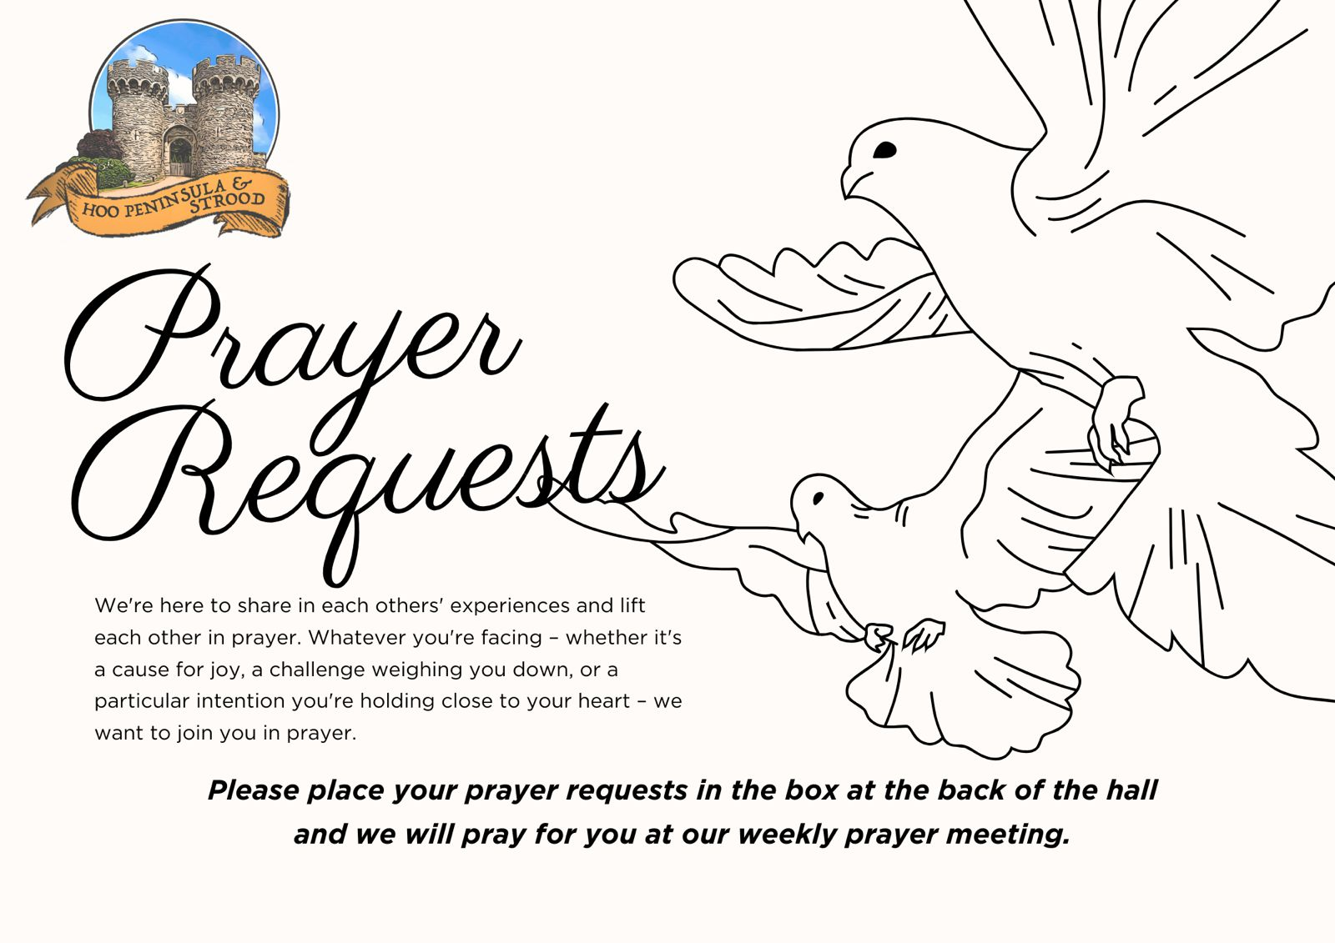

Slide 35


Slide 36
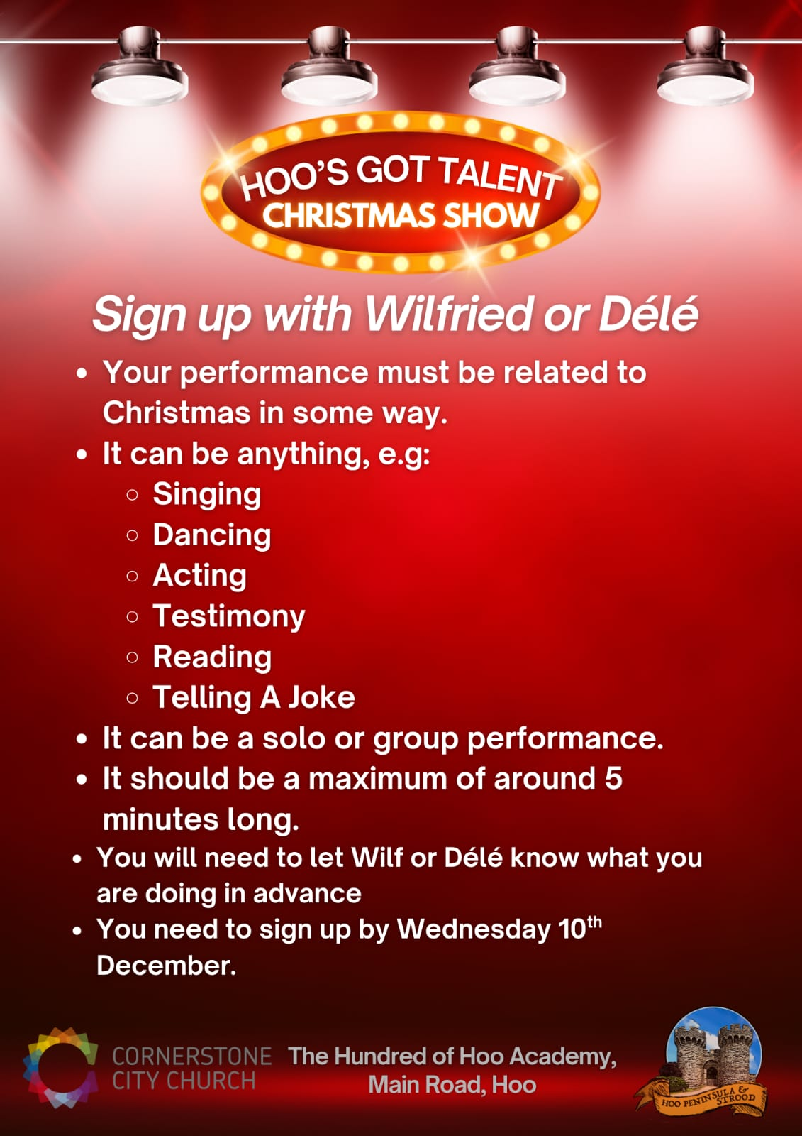

Slide 37

Grow Group 1
On YOUR MARK!

Slide 38
Leaders
Leaderss
Phil & Kim
Maria (Mia) Warren
Matthew Harrison
Richard & Elisha Acheampong
Phil & Kim
Maria (Mia) Warren
Matthew Harrison
Richard & Elisa Acheampong

Slide 39

Storm Walker
Storm Walker
Symbolising, trust in Jesus Christ through life's storms.
Mark 4:35-41

Slide 40



Group Leaders
Micheal and Mwamba
Wilfred and Parveen
Hannah

Slide 41


Slide 42


Slide 43


Slide 44
2 Corinthians 14 May the grace of the Lord Jesus Christ, and the love of God, and the fellowship of the Holy Spirit be with you all
Surely goodness and mercy shall follow us all the days of our lives, and we shall dwell in the house of the Lord forever.

